Slide 1
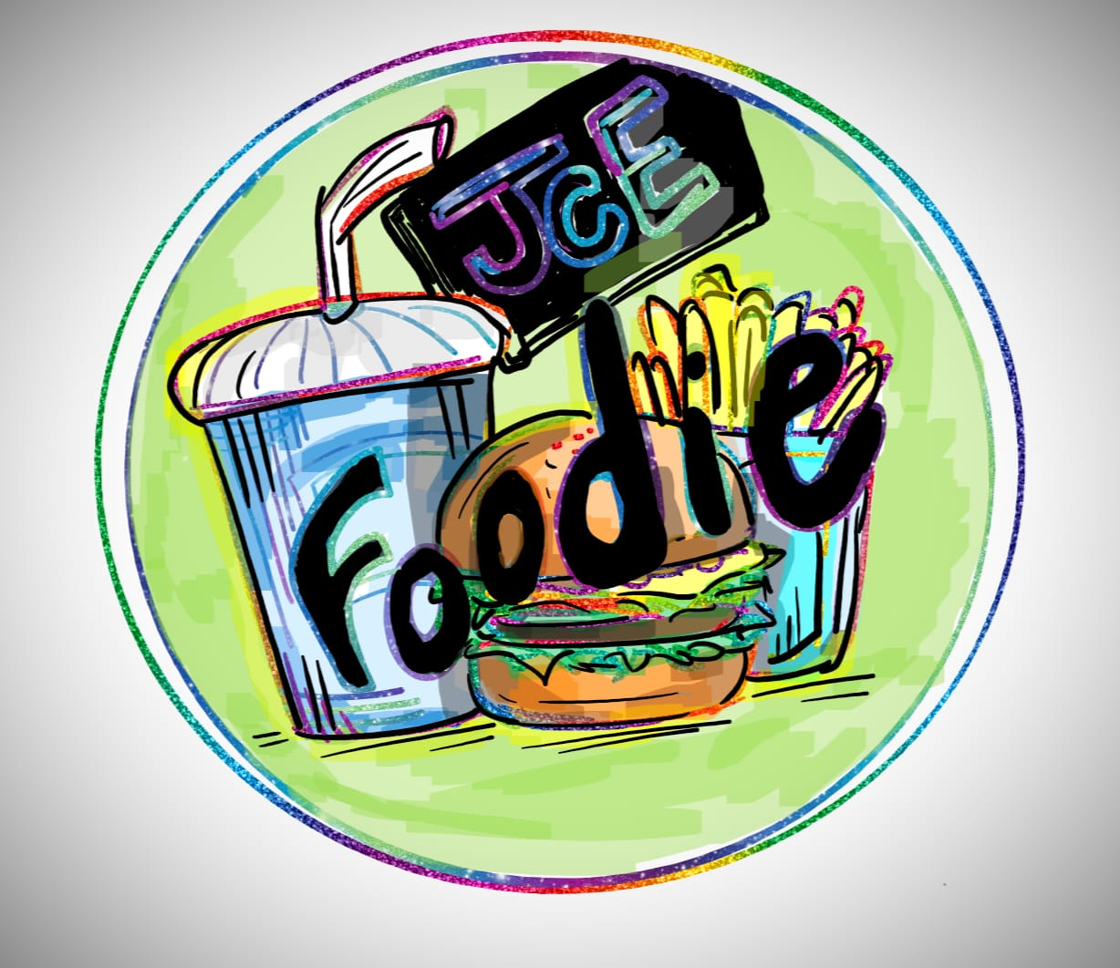

Slide 2

INCEPTION
MOTIVATION FOR IDEA
PERSONAL EXPERIENCES
STAKEHOLDERS EXPERIENCES
UNDERSTANDING THE PROBLEM
DIFFERENCE FROM EXISTING ONES

Slide 3
MOTIVATION FOR IDEA
In star rating, the categories are ranked between one to five stars, with five being the highest and one being the lowest . Disadvantages of a star rating:
The downside to rating scales is the drawback of misperceived information.
The vast majority of users will provide a positive rating; they're using it over competitive alternatives and want to justify their decision.
People interpret the rating differently. As with any grading, some are more inclined to be generous compared to others.

Slide 4
Personal experiences
As a student coming from north India, one of our team members Adishi had difficulty in finding the right cuisine around the college.
As a fresher, it can be overwhelming to find so many dining options in the College, whether it tastes good, if it’s delicious, if it’s expensive and so on.

Slide 5
A fresher’s perspective
Vaibhav (EEE ,1st semester), a student of SJCE lived with one of the team members for a brief period until he got into hostel. During this time he told that he was quite confused with regard to the food options available around the campus.

Slide 6
Understanding the problem
As a fresher who is just getting used to the hostile environment of the hostel, not being able to enjoy the tastes of their hometown can seriously suppress their spirits.
Therefore, it would be very useful to them if there was an easy way for them to know what foods are being served, where and for how much so that they can try them out and feel at home, at least in terms of food.

Slide 7
Differences from existing ones
In existing system, we rate using star rating system which is mostly positively biased.
Because of this biased rating, we aren’t able to get a clear picture of customers opinion.
Hence these, ratings would not give any real insights.
We will construct a comparison based rating system, where users can vote keeping in mind all the factors important to them like price, quantity, quality and other factors.
To compare food items among all the restaurants around the college area.

Slide 8
ELICITATION
STAKEHOLDERS
STUDENTS
FACULTY
OTHERS:
RESTAURENT OWNERS
OUTSIDERS
QUESTIONNAIRES
LIST OF REQUIREMENTS

Slide 9
STAKEHOLDERS
STUDENTS :
Vaibhav ( EEE, 1st Sem )
Narayan Bhat ( CSE, 3rd Sem )
Manjari Ranjan ( CSE, 5th Sem )
Arunima Rashmi Giri ( CSE, 7th Sem )
LECTURERS :
Bindya Ma'am
Ashritha Ma’am

Slide 10
QUESTIONNAIRES
STUDENT :
Did you face any issues while choosing what to eat ?
Are you satisfied with the recommendations ?
If our application was available to you right now, how would you use it’s features ? Does the application help in simplifying tasks ?
LECTURERS :
Did you face any food related issue ?
Do you ask other people for recommendations ?
Do you have any suggestions to improve our app ?

Slide 11

QUESTIONNAIRES
RESTAURANT OWNER :
What are the peak hours for your restaurant ?
Would you be interested in a software that would rank your food with other options around the campus?
If you had the app now, how would you use it’s features ?

Slide 12
ASSOCIATION OF REQUIREMENTS
Student :
Honest reviews about food items, Quality, Quantity, Waiting time, price, regular updates, food delivering rates.
Teachers :
Honest reviews about food items, Quality, Quantity, Waiting time, price, regular updates, food delivering rates.
Restaurant owners :
Feedback from customers, regular updates.

Slide 13
ELABORATION
ACTORS AND ROLES
USER
RESTAURANT OWNER
SOFTWARE MANAGEMENT TEAM
REFINED MODELS

Slide 14
Refined model
Light weight Android based Application
Comapare any two restaurants in terms of a common dish
Provide ranking for the common dishes based on the feedback
Provide Information such as menu, preparation time, price, qualilty and quantity

Slide 15
Refined model
Provide Information on delivery, timings and peak hours
Have Separate Profiles based on the type of User using Machine Learning
Simple, Clean and Neat UI
Integrate Google Maps to provide navigation facility

Slide 16
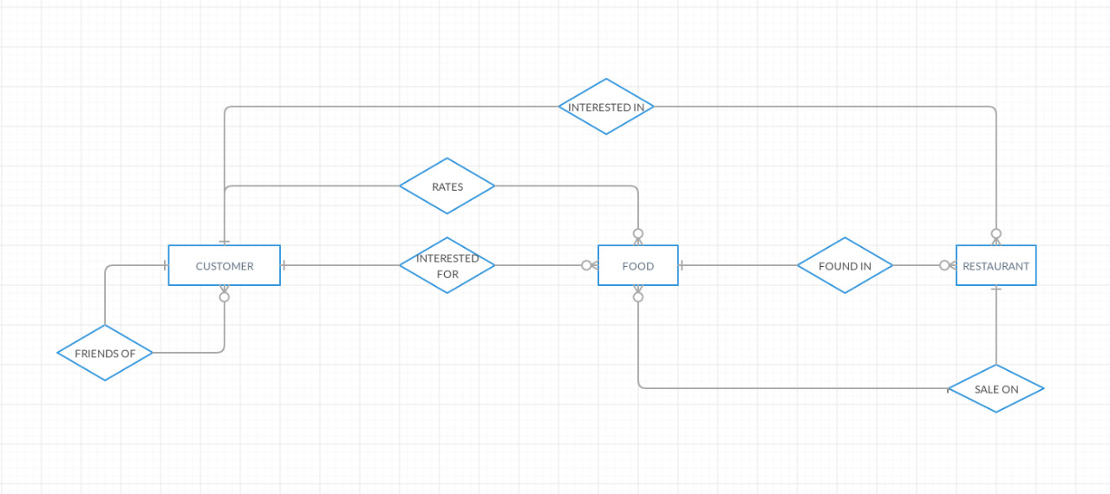
Actors and roles
The ER Diagram can be visualized as follows

Slide 17

actors and roles
Customer : Different customers including their category (freshers, veterans, People Nearby).
Freshers : would need recommendations.
Veterans : can only rate food and get recommendations.
People nearby : will include people opting for the service situated outside the college in the nearby areas.

Slide 18
ACTORS AND ROLES
Food : This entity would have all information about the food items including its ratings, vicinity dynamically with the customer's location),price ,discount, picture(blob), and the number of friend who like that item.
Shop : This entity will contain all the information regarding the shop, its contact, delivery options, its location and the general popularity.

Slide 19
ACTORS AND ROLES
The relationships :
Interested In : This is a relationship existing between Customers and Shops.
Interested In: This is relationship connecting the customers and the food items.
Found In : This relation links the different food items to the shops they are found in.
Sale On : This relation lets shops to provide different kinds of discounts on food items.
Friends of : This is a self relationship on customers keeping a track of their friend circles.
Rate : This relation allows customers to rate .

Slide 20

negotiation
Due to scope and feasibility issues, we had to cut down a few requirements that we had in our mind.
We got some suggestions and feedbacks by talking back to the stakeholders.

Slide 21
negotiation
Problems with implementing machine learning in the project currently :
Lack of quality data
Inadequate infrastructure
Implementation issues
Lack of skilled resources
For the first iteration we have to consider only those restaurants around campus, rather than all of Mysore due to scalability constraints.

Slide 22
Specifications
Platform : The software will be built on the Android Platform. To use our application user should have a smart phone.
Input : Preference in the form of selection among two restaurants for common dishes. Updates to information on the menu.
Output : Rankings for food. Menu of the restaurants, along with other information like quality, quantity, price and so on. Timings, ambience and other factors of the restaurant.

Slide 23
VALIDATION
Is each requirement bounded and unambiguous?
Is the requirement necessary or does it represent an add-on feature that may not be essential to the objective of the system?
Is each requirement achievable in the technical environment that will house the system or product?
Do any requirements conflict with other requirements?
Does each requirement have attribution? That is, is a source (generally, a specific individual) noted for each requirement?
Is the specification structured in a way that leads to easy understanding, easy reference, and easy translation into more technical work products?

Slide 24

REQUIREment MANAGEMENT
Requirement Management can be deﬁned as a process of eliciting, documenting, organizing, and controlling changes to the requirements.
We will keep updating additional features as per customer feedbacks and try to make the user interface simple and easier to access.

Slide 25
Roles and responsibilities
Eeshaan Achar : Project Leader, Backend Developer
Navneet G Hosmane : Lead Developer, Tester
Adishi Jha : Backend Developer, Tester
Anirudh D Pai : Business Analyst, Frontend Developer
Donapati Venkata Sreekar Reddy : Business Analyst, Frontend Developer

Slide 26
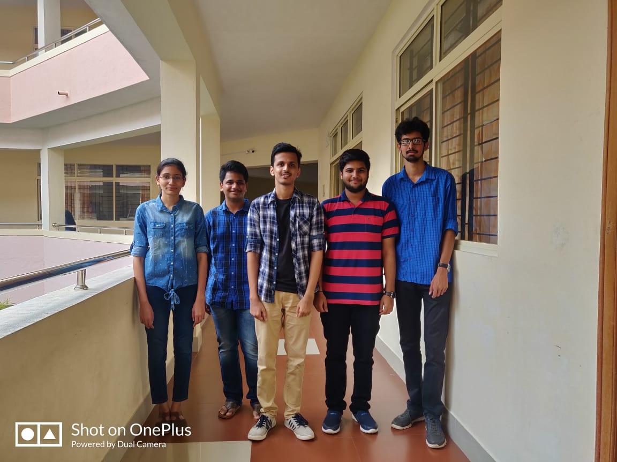

Slide 27
Behind The Scenes

Slide 28
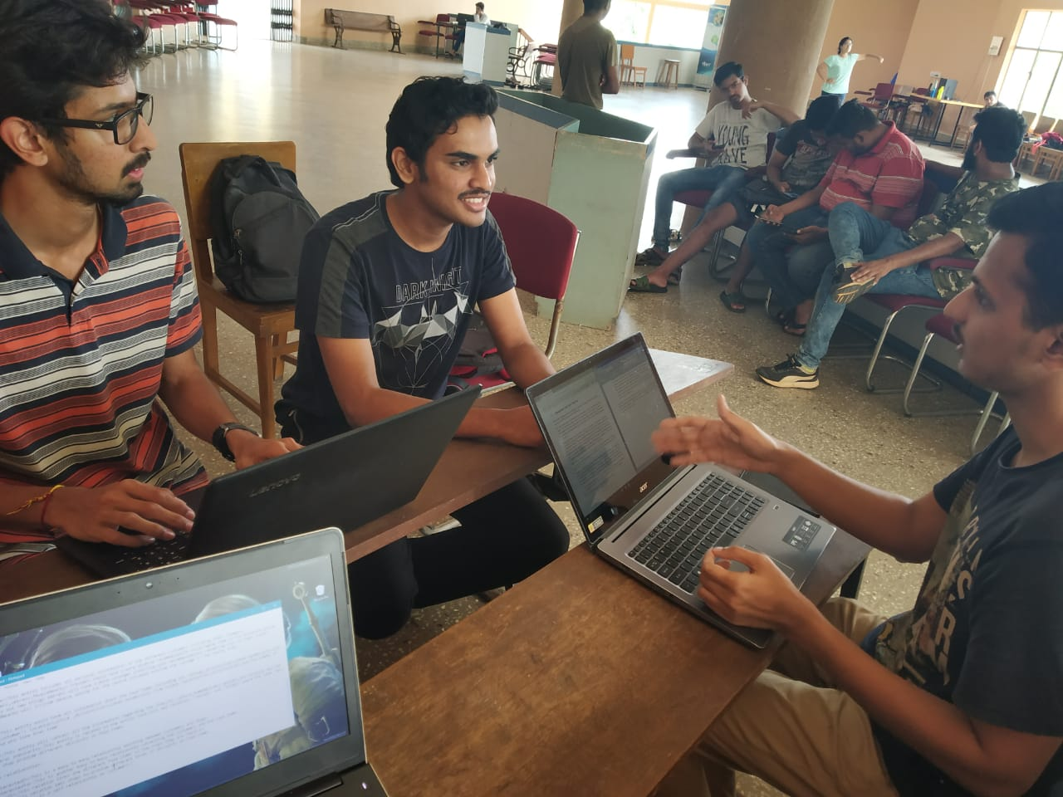

Slide 29
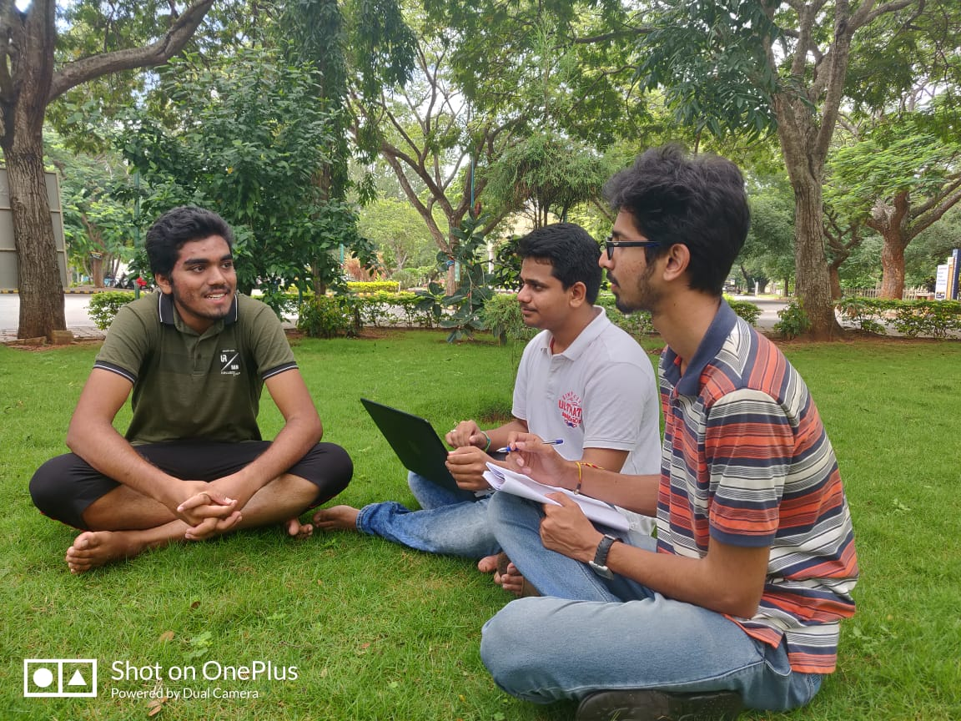

Slide 30
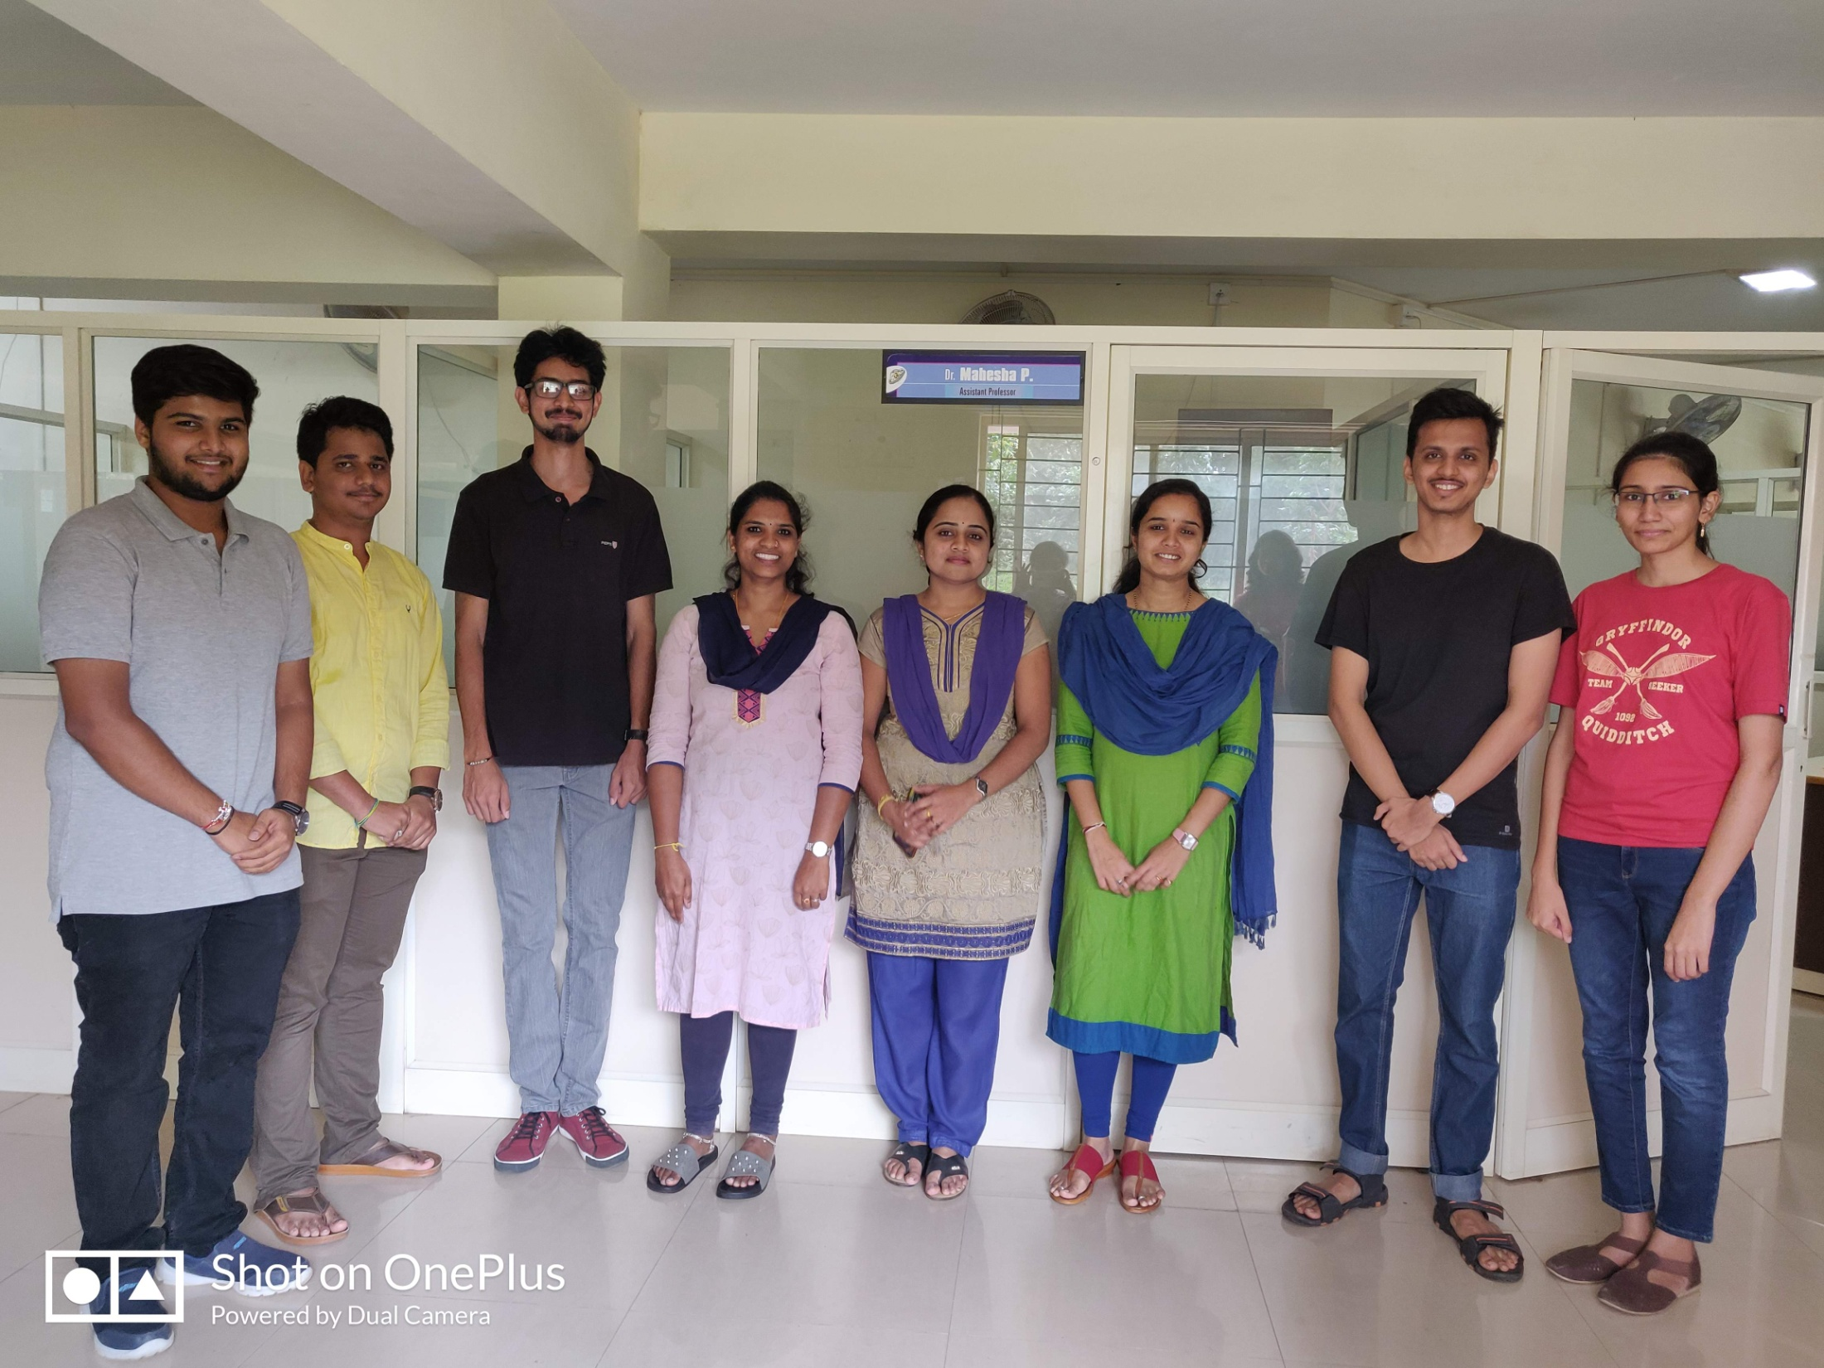

Slide 31
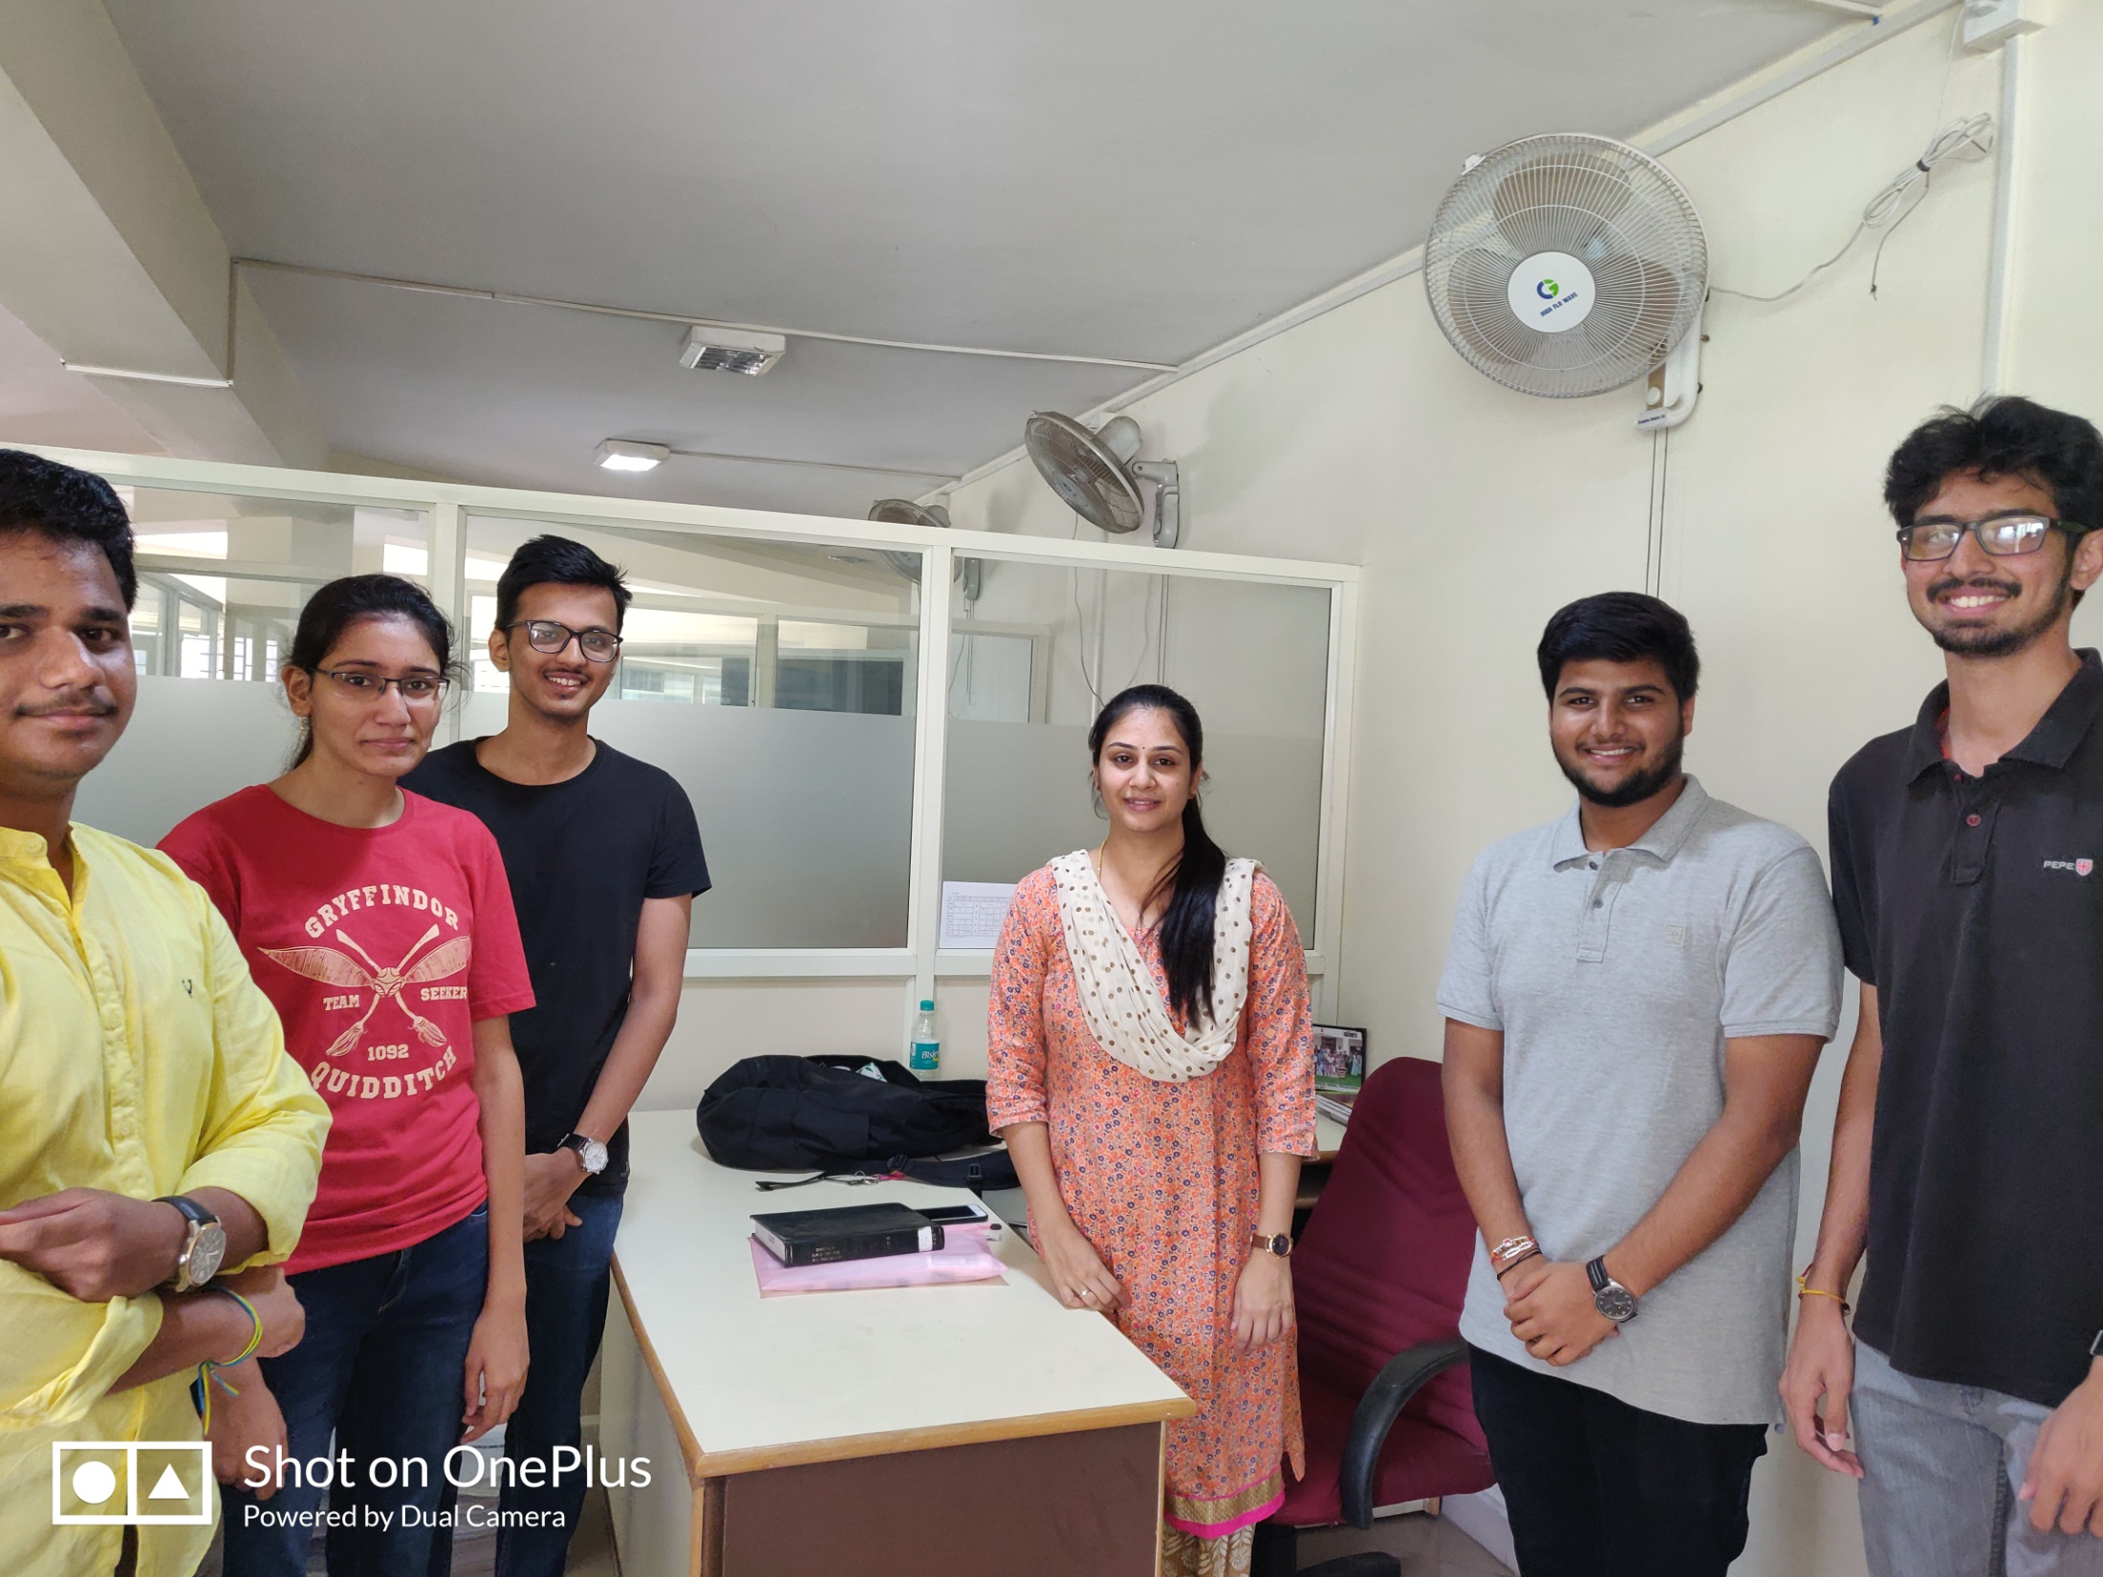

Slide 32
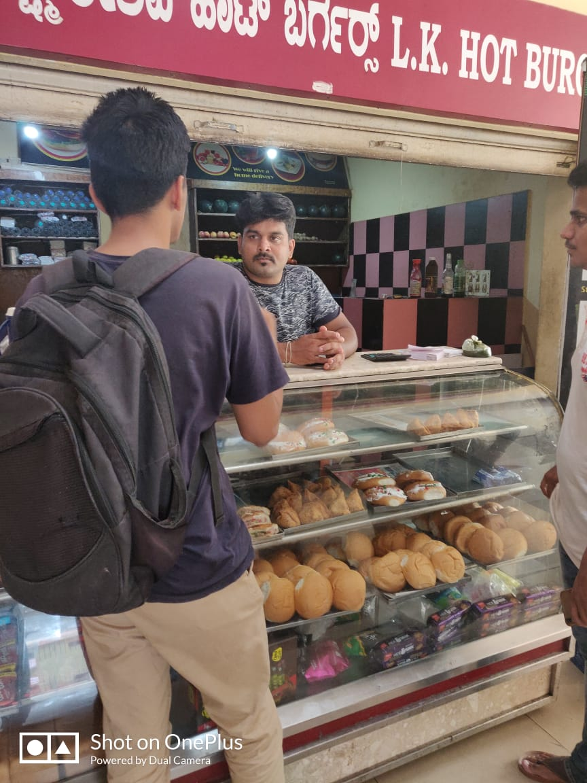

Slide 33
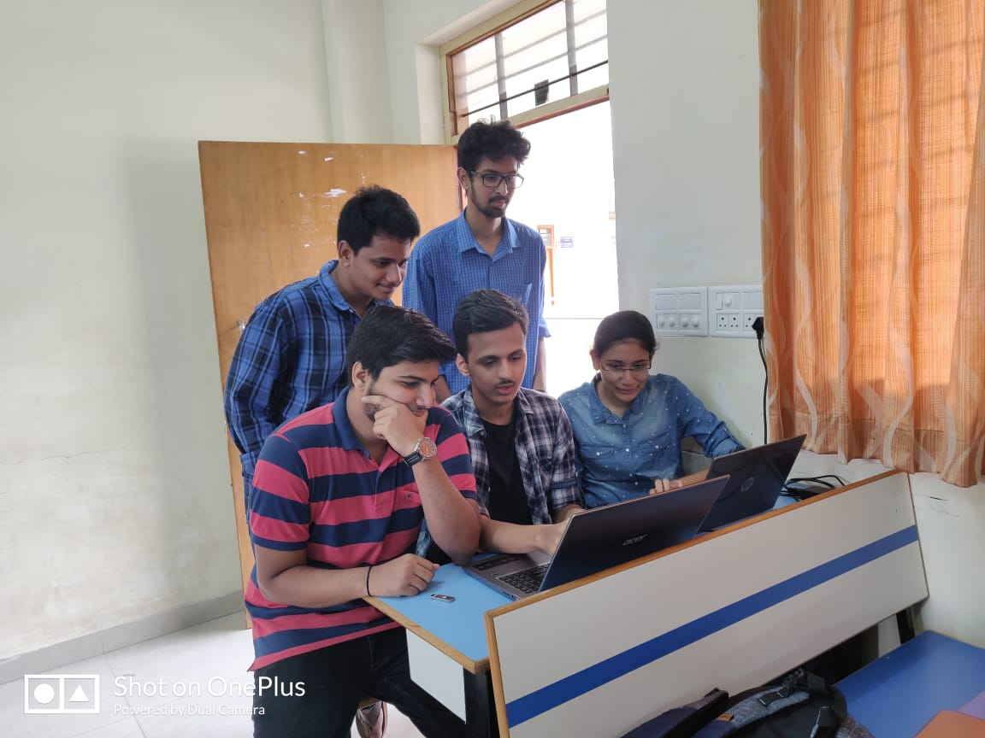

Slide 34
references
Roger S Pressman: Software Engineering - A Practitioners approach, 8th edition, McGraw-Hill Publication, 2015.
https://www.geeksforgeeks.org/software-engineering-requirements-engineering-process/
https://www.tutorialspoint.com/software_engineering/software_requirements.htm
Seniors, CSE, JSS S&T University

Slide 35

THANK YOU

